Slide 1
Chap#11
User Interface Design

Slide 2
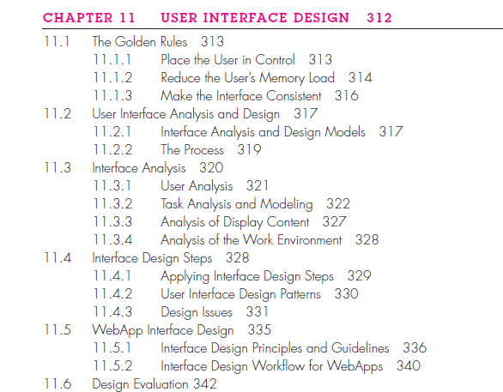
Outline

Slide 3
THE GOLDEN RULES
In his book on interface design, Theo Mandel [Man97] coins three golden rules:
1. Place the user in control.
2. Reduce the user’s memory load.
3. Make the interface consistent.
These golden rules actually form the basis for a set of user interface design principles that guide this important aspect of software design.

Slide 4
11.1.1 Place the User in Control
End-user was asked about the attributes
wanted a system that reacted to her needs
simplify the mode of interaction
Define interaction modes in a way that does not force a user into unnecessary or undesired actions.
Provide for flexible interaction(Choice of interaction)
Allow user interaction to be interruptible and undoable
Streamline interaction as skill levels advance and allow the interaction to be customized.
Hide technical internals from the casual user
Design for direct interaction with objects that appear on the screen(Control)

Slide 5
11.1.2 Reduce the User’s Memory Load
Reduce demand on short-term memory (remember)
Establish meaningful defaults (reset option)
Define shortcuts that are intuitive (if stuck utilize)
The visual layout of the interface should be based on a real-world metaphor.
Disclose information in a progressive fashion

Slide 6
11.1.3 Make the Interface Consistent
The interface should present and acquire information in a consistent fashion. This implies that (1) all visual information is organized according to design rules that are maintained throughout all screen displays, (2) input mechanisms are constrained to a limited set that is used consistently throughout the application, and (3) mechanisms for navigating from task to task are consistently defined and implemented.
Allow the user to put the current task into a meaningful context.
Maintain consistency across a family of applications(same design rules)
If past interactive models have created user expectations, do not make changes unless there is a compelling reason to do so.

Slide 7
11.2 USER INTERFACE ANALYSIS AND DESIGN
The overall process for analyzing and designing a user interface begins with the creation of different models of system function.
You begin by dealing with human- and computer-oriented tasks that are required to achieve system function and then considering the design issues that apply to all interface designs.
Tools are used to prototype and ultimately implement the design model, and the result is evaluated by end users for quality.
11.2.1 Interface Analysis and Design Models
Four different models come into play when a user interface is to be analyzed and designed are user model, design model, system perception(image of the system that end users carry in their heads) and implementation model(interface syntax and semantics).
In addition, users can be categorized as: Novices (little semantic knowledge of the application or computer usage in general), Knowledgeable, intermittent users(Reasonable semantic knowledge), Knowledgeable, frequent users(Good semantic and syntactic knowledge)

Slide 8
11.2.2 The Process
The analysis and design process for user interfaces is iterative and can be represented using a spiral model.
four distinct framework activities (1) interface analysis and modeling, (2) interface design, (3) interface construction, and (4) interface validation.
Interface analysis focuses on the profile of the users who will interact with the system.
The goal of interface design is to define a set of interface objects and actions.
Interface construction normally begins with the creation of a prototype that enables usage scenarios to be evaluated.
Interface validation focuses on the ability of the interface to implement every user task correctly, easy to use, easy to learn and users’ acceptance of the interface.

Slide 9
11.3 INTERFACE ANALYSIS
understand the problem before you attempt to design a solution, interact, perform, content, environment.
11.3.1 User Analysis: User Interviews, Sales input, Marketing input, Support input.
11.3.2 Task Analysis and Modeling: Use cases(actor interacts with a system), Task elaboration(discussed stepwise elaboration), Object elaboration(extract the physical objects that are used by the interior designer), Workflow analysis(understand how a work process is completed), Hierarchical representation(process of elaboration occurs as you begin to analyze the interface)

Slide 10
11.3.3 Analysis of Display Content
The user tasks identified lead to the presentation of a variety of different types of content. For modern applications, display content can range from character-based reports (e.g., a spreadsheet), graphical displays (e.g., a histogram, a 3-D model, a picture of a person), or specialized information (e.g., audio or video files). The analysis modeling techniques discussed identify the output data objects that are produced by an application.
11.3.4 Analysis of the Work Environment
People do not perform their work in isolation. They are influenced by the activity around them, the physical characteristics of the workplace, the type of equipment they are using, and the work relationships they have with other people. If the products you design do not fit into the environment, they may be difficult or frustrating to use.

